Slide 1
Module 7: Build Power Automate cloud flows

Slide 2
Cloud flows
Fundamentals of cloud flows
Triggers
Actions

Slide 3
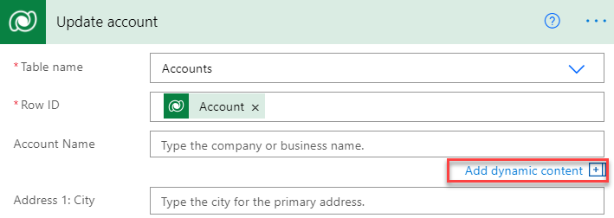
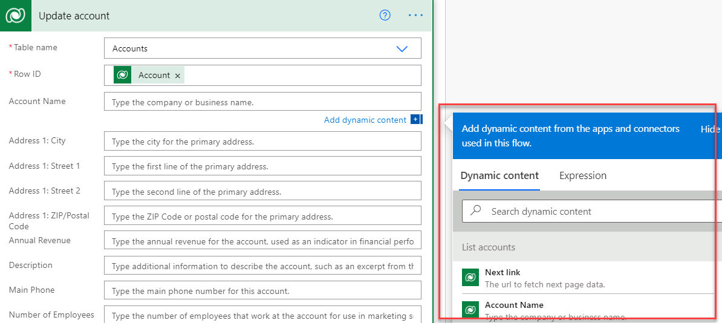
Dynamic data
Use dynamic content panel to reference data from prior steps in a flow and dynamically bind it to current properties
Dynamic content panel shown when clicking in a property value on a step flow

Slide 4
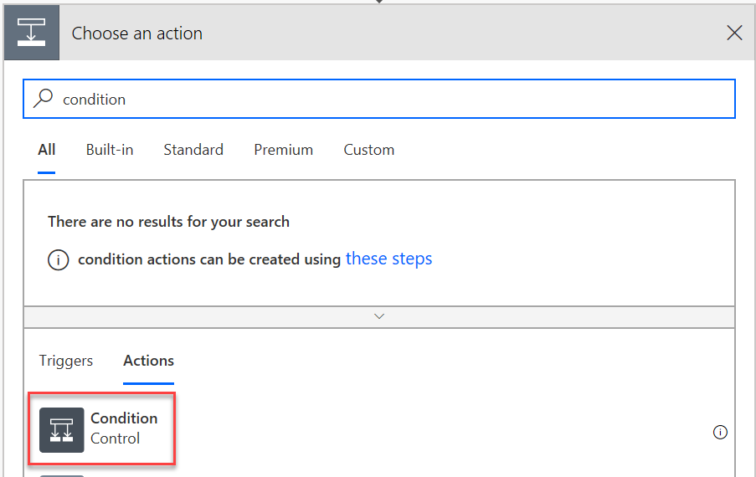
Conditions and switches
Conditions and switches offer ways to introduce conditional branching into a flow
Using conditions
Search actions on “Condition” and select
Using switches
Searching on “Switch” and add to flow

Slide 5
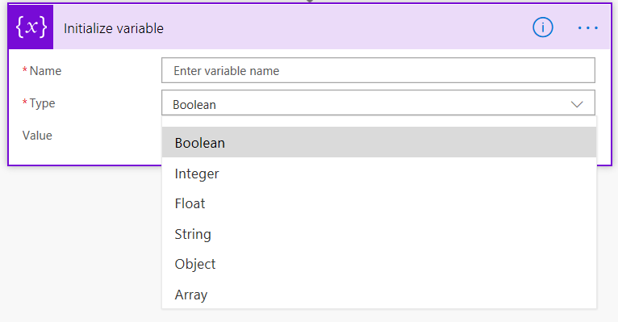
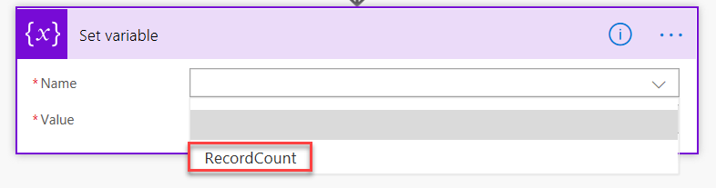
Variables
First initialized, then set, incremented or decremented depending on their data type
Can be used in condition criteria to hold a value you plan to use later

Slide 6
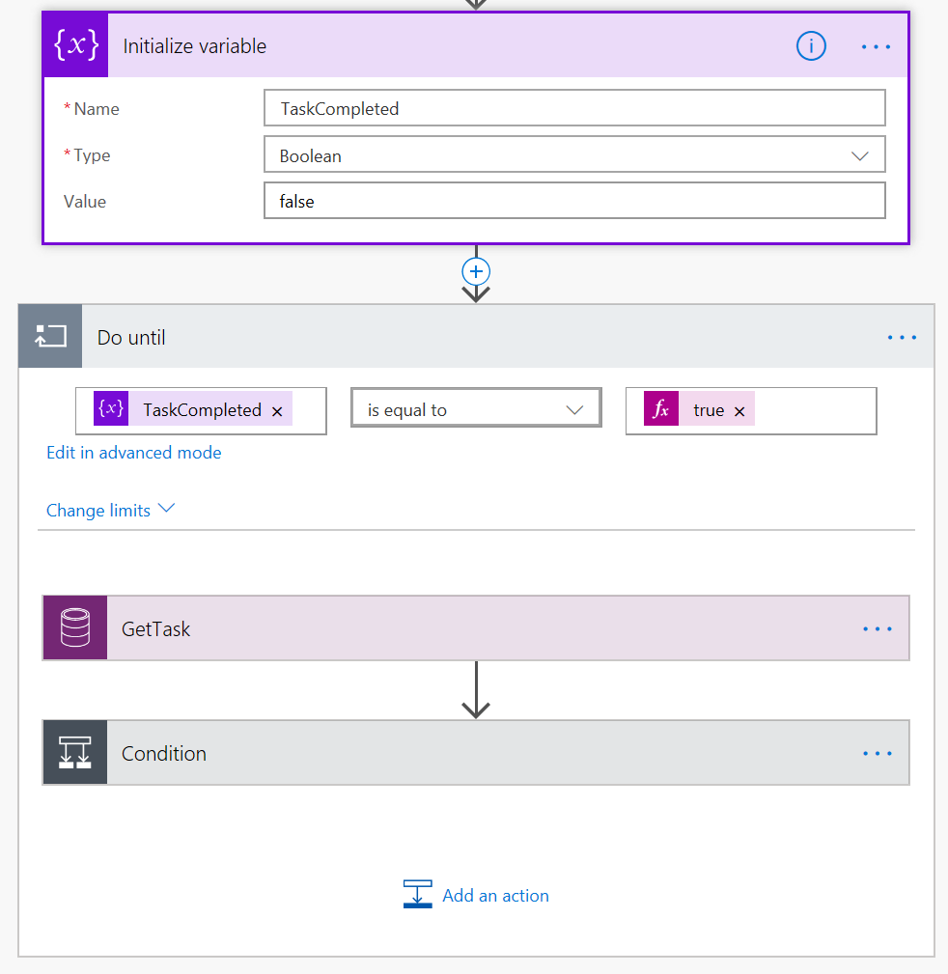
Looping
Apply for each
Executes for each item in an array
Do until
Executes until a condition is met

Slide 7
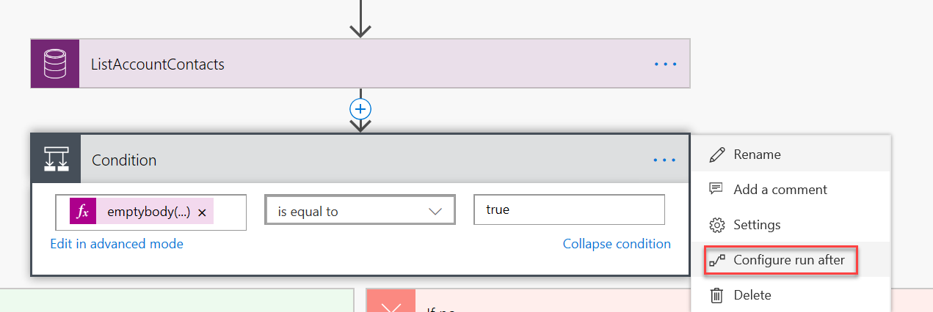
Error handling
Goal: Recover work already completed by the flow before the error occurred
By default, flow will keep running through its step as long as prior actions have been successful
Errors:
Failed
Skipped
Timed out

Slide 8
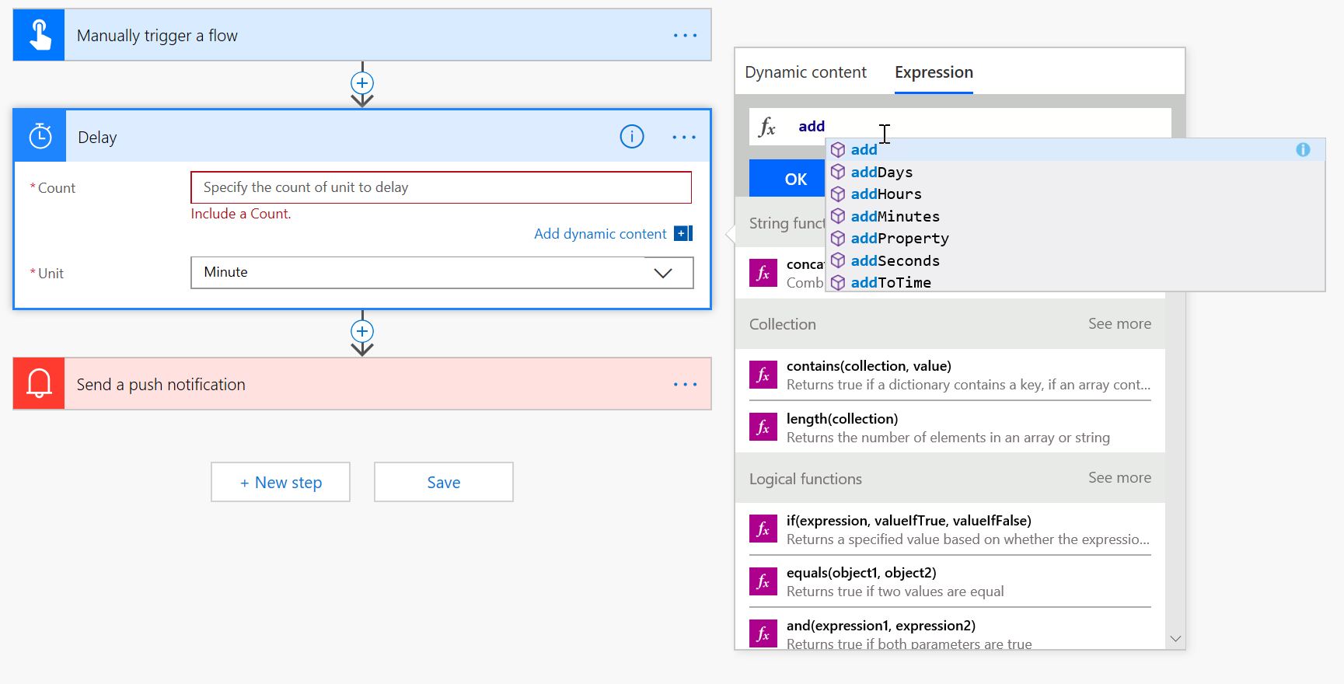
Expressions

Slide 9
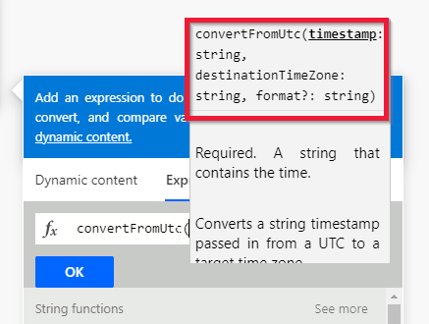
Auto suggest, hints, and links in the formula bar
When you enter a function in the formula bar, you'll see a pop-up with syntax suggestions.
Timestamp is required and expects a string
destinationTimeZone is required and expects a string
format? is optional and expects a string.
The question mark at the end of format tells you that it is an optional input.

Slide 10
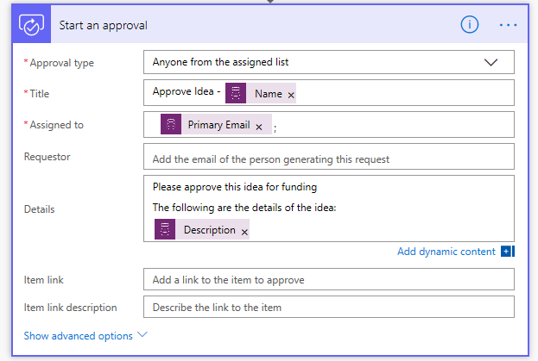
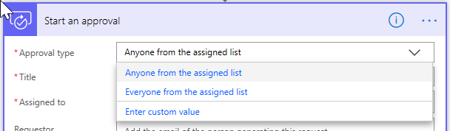
Approval flow overview
Types of approvals
Single
Sequential
Parallel
Use cases
Approval can be data-driven from Dataverse
Allows extending approvals outside PowerApps users
Flexibility to construct an approval flow that matches your scenario

Slide 11
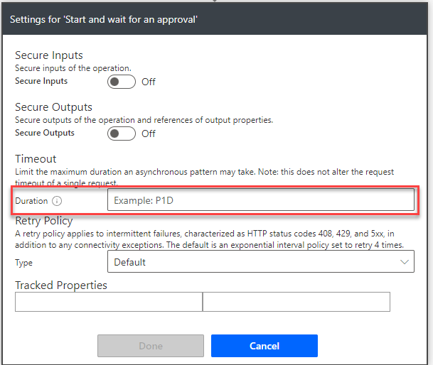
Approval flow settings
Approvals will timeout after 30 days
Can configure, format is ISO date format
Settings can be found via the ellipsis on the flow step

Slide 12
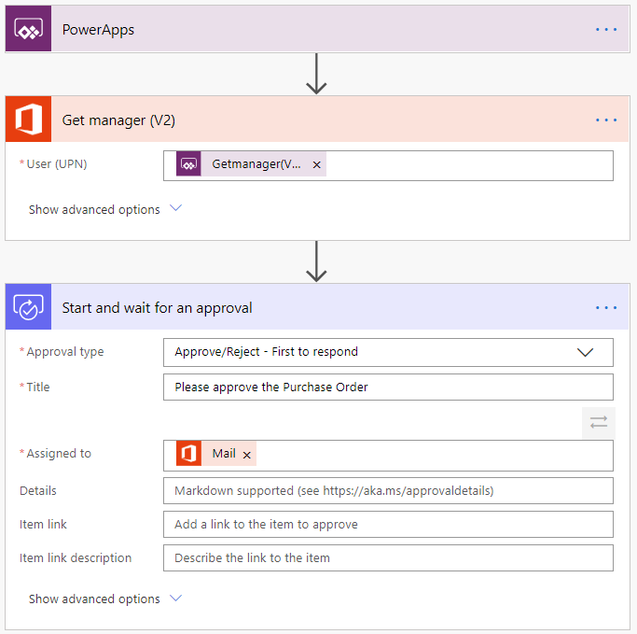
Approval flow example

Slide 13
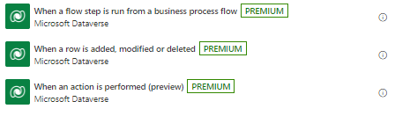
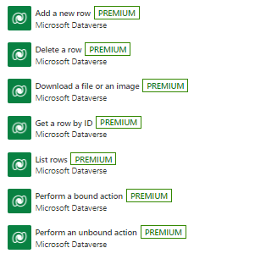
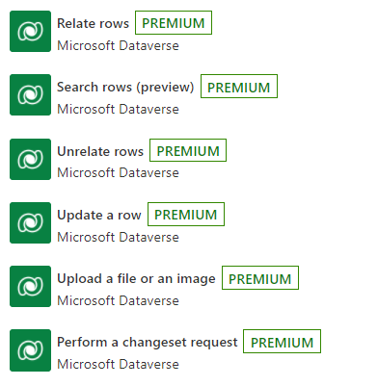
Microsoft Dataverse Triggers and Actions
Triggers
Actions

Slide 14
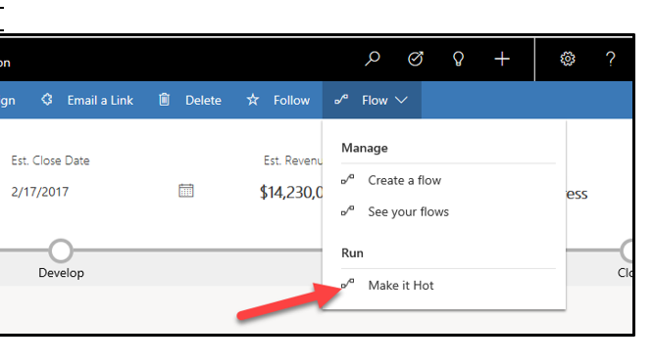
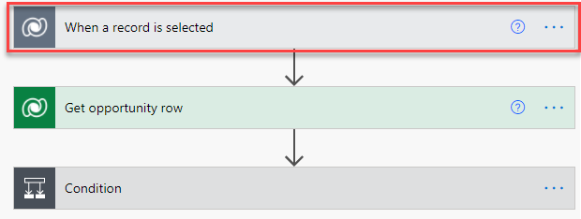
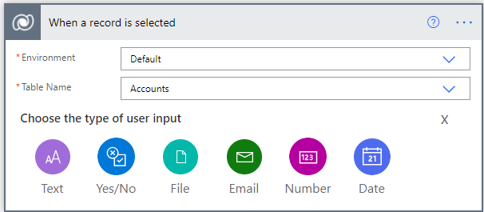
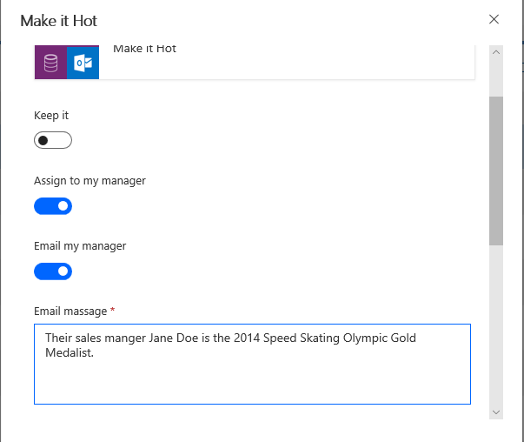
Run flows on selected records

Slide 15
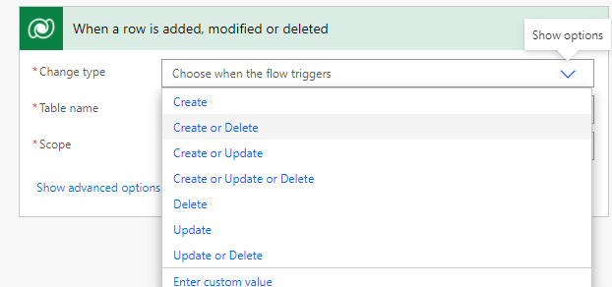
Microsoft Dataverse Connector Triggers
Microsoft Dataverse

Slide 16
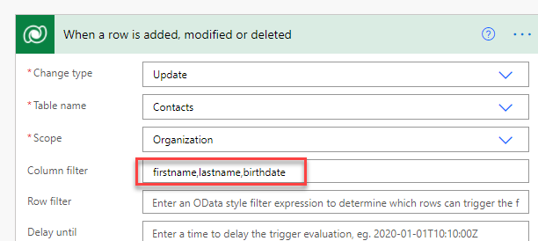
Filtering Update Triggers
Microsoft Dataverse

Slide 17
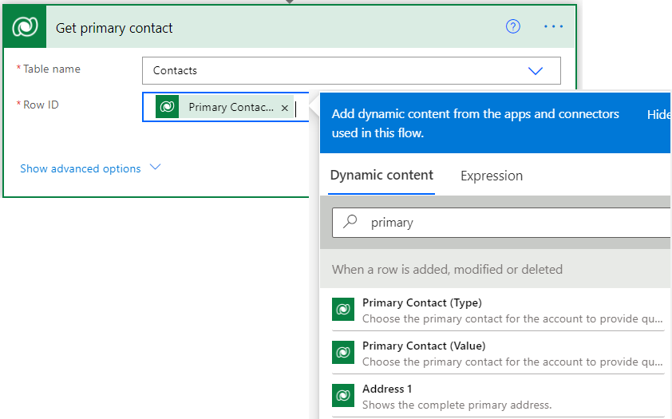
Querying data
Get Row (Record) action Retrieve a single row
List Row (Record) action Retrieve an array of rows
Filter Query
Order By
Top Count
Expand Query

Slide 18
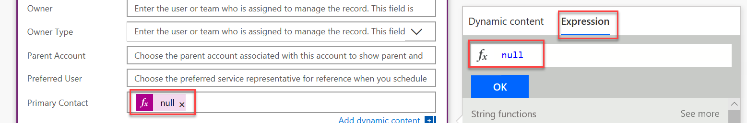
Creating and updating data
Create Row (Record)
Provide minimum required columns (fields) to create row (record)
Update Row (Record)
Provide item identifier
Set column to null to clear

Slide 19

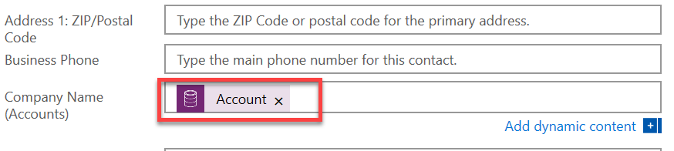
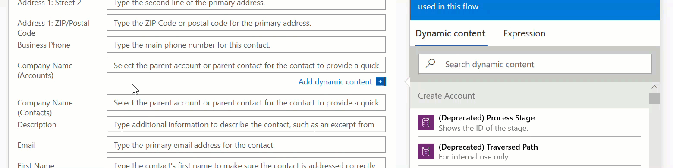

Setting Lookup Column Values
Uses OData syntax

Slide 20
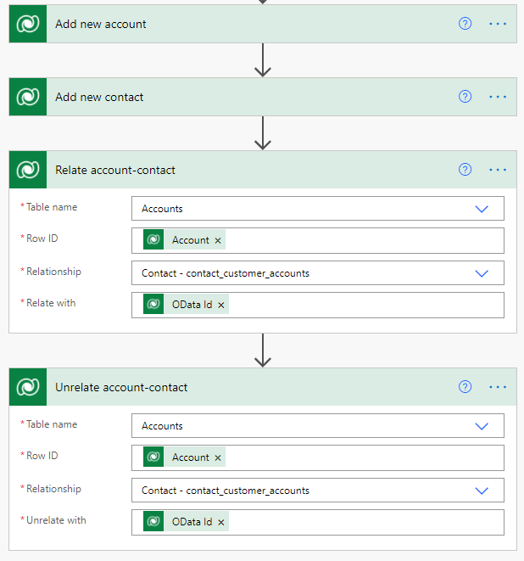
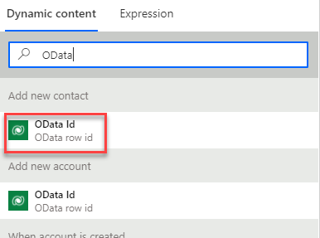
Relate and Unrelate Rows

Slide 21
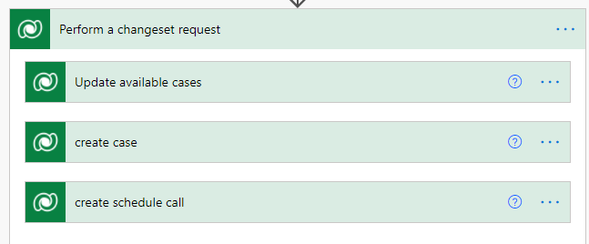
Using change sets
Operations run in a transaction
Used inside of batch scopes
Microsoft Dataverse Connector actions only, create update delete

Slide 22
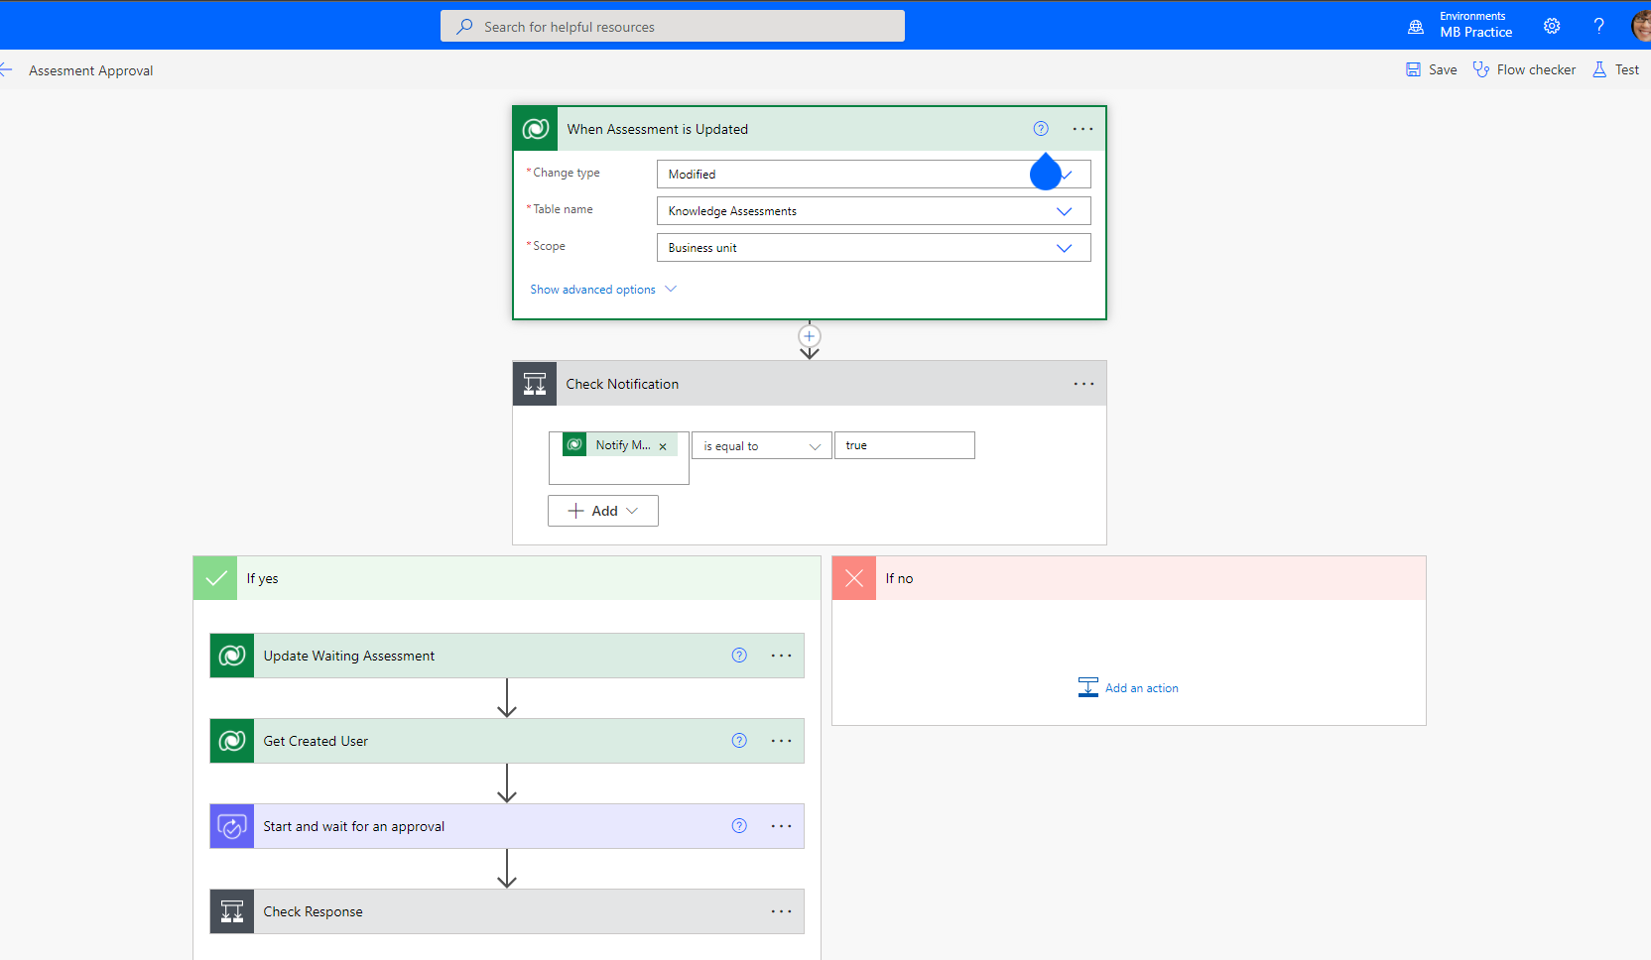
Flow checker and testing

Slide 23
Module 7 practice labs
Lab 7.1: Create a flow
Lab 7.2: Build an approval flow
(Note: it takes several minutes to deploy the solution to support approvals)

Slide 24
Summary
Cloud flows offer several automation capabilities
Flows can be authored by makers of all skill levels
Some are quite complicated, some are quite simple
Working with Dataverse is native and has several options to make the flows complete the tasks needed

Slide 25
close

